Slide 1
Coding Standards
Coding Standards is critical in .NET and C# development to ensure code is clean, maintainable, and consistent.
Below are main aspects of coding standards with C#/.NET examples:
1. Naming Conventions
2. Indentation and Formatting
3. Comments and Documentation
4. Code Readability

Slide 2
Coding Standards
1. Naming Conventions
Helps improve clarity and maintain a consistent naming style across your codebase.
General Rules:
Use PascalCase for:
Class names (CustomerService)
Method names (GetCustomerById)
Property names (FirstName)
Constants (MaxRetryCount)
Use camelCase for:
Local variables (orderCount)
Method parameters (userId)
Private fields (commonly prefixed with _ → _logger)
Use ALL_CAPS for environment variables

Slide 3
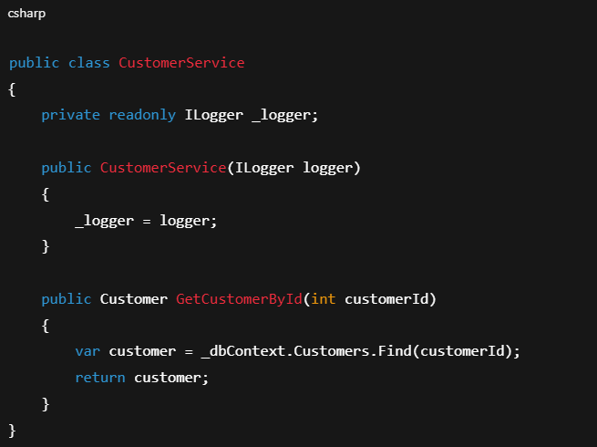
Coding Standards
Example:

Slide 4
Coding Standards
2. Indentation and Formatting
Good indentation helps visually structure your code blocks.
General Rules:
Use PascalCase for:
Use 4 spaces per indentation level (no tabs)
Always use braces {}, even for single-line blocks
Keep line length under 100–120 characters
Insert blank lines between methods or major blocks for readability

Slide 5
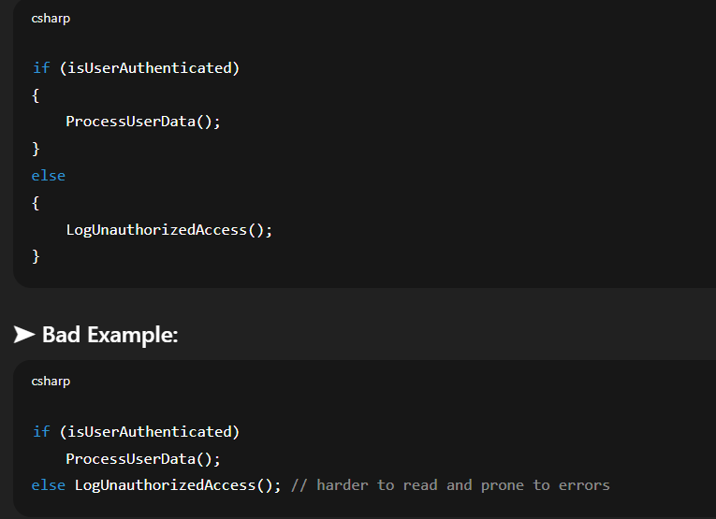
Coding Standards
Example:

Slide 6
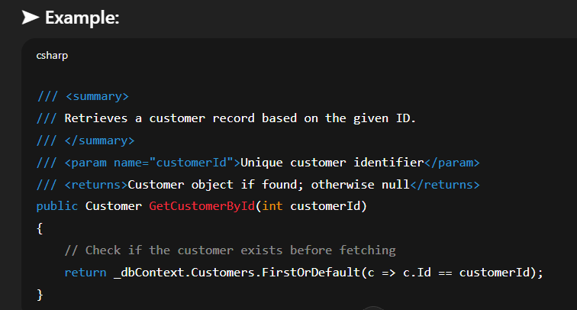
Coding Standards
3. Comments and Documentation
Comments should explain "why", not "what" — unless the logic is complex.
Types:
Inline comments: For complex or non-obvious logic
Method/Class documentation: Use XML documentation (///) for public members

Slide 7
Coding Standards
4. Code Readability
Readable code is clean, concise, and expressive.
➤ Best Practices:
Use meaningful names (var orderList = GetOrders() instead of var x = GetOrders())
Avoid deep nesting — use early return
Break large methods into smaller ones
Keep methods focused on a single responsibility

Slide 8
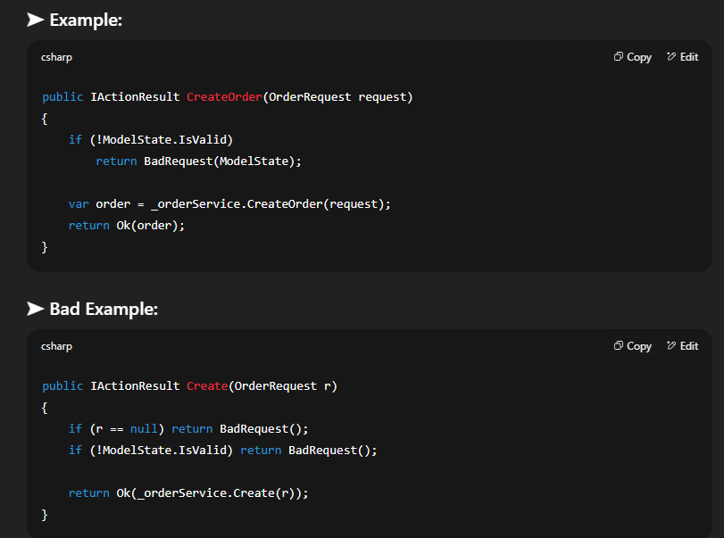
Coding Standards

Slide 9
Coding Standards
Aspect | Rule/Best Practice | Style
Class Name | PascalCase | CustomerService
Variable Name | camelCase | customerId
Constants | PascalCase or ALL_CAPS (for config) | MaxLimit or API_KEY
Braces | Always use | if (condition) { ... }
Indentation | 4 spaces
Line Length | Max 100–120 chars
Comments | Explain "why", not "what" | /// <summary> docs
Method Length | Max 20–30 lines; break into smaller functions
Avoid Nesting | Use early returns

Slide 10
Code Reviews
Code reviews are a crucial part of the software development lifecycle.
They ensure code quality, maintainability, security, and team collaboration.
Core Reviews are two major types
Peer Reviews
Automated Code Analysis

Slide 11
Peer Reviews (Manual Code Reviews)
A peer review is the manual inspection of code by another developer before it is merged into the main branch (e.g., via a Pull Request in GitHub/GitLab/Azure DevOps).
🔷 Objectives:
Catch bugs early
Ensure code meets coding standards
Verify logic, readability, and test coverage
Share knowledge among team members

Slide 12
Peer Reviews (Manual Code Reviews)
🔷 Typical Review Process:
Developer pushes code to a feature branch.
Opens a Pull Request (PR).
One or more peers review the code:
Check for business logic correctness
Verify naming, formatting, null checks, exceptions
Ensure test cases exist and pass
Review for duplication or unnecessary complexity
Peers approve or request changes.
Code is merged after all approvals.

Slide 13
Peer Reviews (Manual Code Reviews)
What Reviewers Check For:
Aspect | What to Look For
Functionality | Does the code meet requirements?
Readability | Is it easy to understand?
Maintainability | Will it be easy to change later?
Testing | Are unit tests present and valid?
Security | Any potential vulnerabilities?
Performance | Is it efficient? Are there better approaches?

Slide 14
Peer Reviews (Manual Code Reviews)
🔷 Example Tools:
GitHub Pull Requests
Azure DevOps PR reviews
Bitbucket Code Reviews
GitLab Merge Requests

Slide 15
2. Automated Code Analysis (Static Code Analysis)
Automated tools scan your source code without executing it. These tools help enforce coding standards, detect bugs, and identify potential vulnerabilities.
🔷 Benefits:
Consistency across the codebase
Early detection of errors (before runtime)
Save reviewers’ time on stylistic issues
Continuous feedback in CI/CD pipelines

Slide 16
2. Automated Code Analysis (Static Code Analysis)
🔷 Common Tools in .NET/C#:
Tool | Purpose
Roslyn Analyzers | Built into .NET SDK; checks style, usage, and common mistakes
StyleCop Analyzers | Enforces C# style and naming rules
SonarQube / SonarCloud | Deep static analysis including code smells, bugs, and security issues
ReSharper / Rider | IDE tools to refactor and detect issues
FxCop (legacy) | Older code analysis tool (replaced by Roslyn-based analyzers)

Slide 17
Peer Review Vs Automated Code Analysis
🔷 Common Tools in .NET/C#:
Feature | Peer Review | Automated Code Analysis
Who reviews | Human peers | Tools (e.g., Roslyn, SonarQube)
Focus areas | Logic, readability, architecture | Style, bugs, security patterns
Speed | Slower (manual) | Fast (part of build process)
Strengths | Subjective insights, domain knowledge | Consistent, scalable, early feedback
Tools | GitHub PR, Azure DevOps | StyleCop, Roslyn, SonarQube

